Slide 1

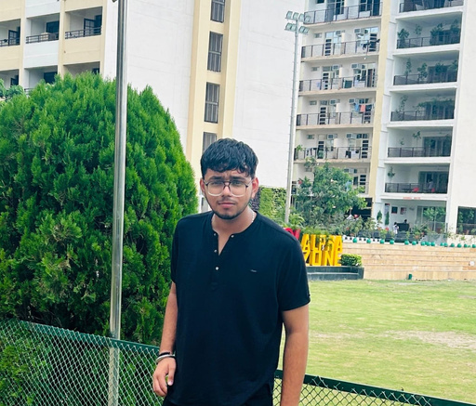



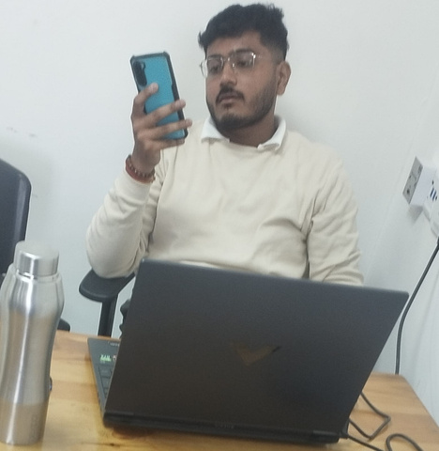
OUR TEAM
RISHI
CONFUSED MAN.......
6284962213
rishibhateja78_
ground mai..................
ASHISH SIR
KYO NAHI HO RAHI PADAHI!..
LIKHO 98
SUDHAR JAO....
JAI MAHARASHATRA

